Slide 1
Lumiere Beauty Paid Media Performance
Oct-Nov Campaign Analysis

Slide 2
Multi-channel campaign analysis across Meta, Google, youTube & Influencers
Objective: Evaluate performance & identify optimization opportunities

Slide 3
EXECUTIVE SUMMARY
Retargeting campaigns delivered highest efficiency and conversions
Brand keywords drove majority of revenue in search campaigns
Feed placement & mobile devices dominated overall performance

Slide 4
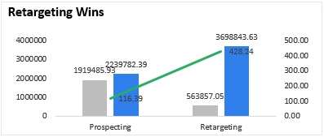
Retargeting Wins
Retargeting generated significantly higher revenue vs prospecting
Prospecting showed lower efficiency (low ROAS)
Suggestion: Increase retargeting budget

Slide 5
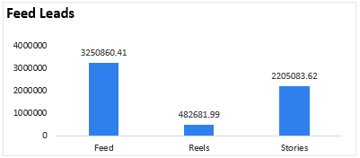
Feed Leads
Feed placement contributed highest conversions
Reels & Stories showed lower performance
Optimize creatives for Feed placements

Slide 6
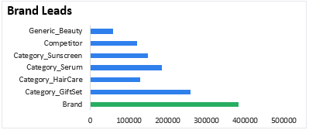
Brand Leads
Brand keywords drove majority of conversions
Generic & competitor keywords underperformed
Strong brand intent observed

Slide 7
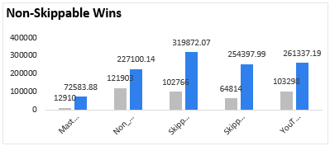
Non-Skippable Wins
Non-skippable ads showed higher engagement
Skippable ads delivered lower completion
Focus on high-attention formats

Slide 8
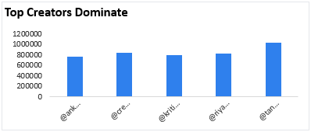
Top Creators Dominate
Few influencers contributed majority revenue
Long-tail creators had minimal impact
Focus budget on top performers

Slide 9
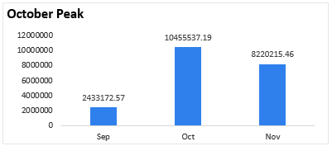
October Peak
Revenue peaked in October (festive demand)
Strong correlation between campaign spend & sales
Performance normalized post peak

Slide 10
CHANNEL SCORECARD
Channel | Performance
Meta | 🟢
Google | 🟢
YouTube | 🟠
Influencer | 🟢

Slide 11
RECOMMENDATIONS – DO DIFFERENTLY
Reduce spend on underperforming placements
Optimize non-performing keyword groups
Improve targeting for prospecting campaigns

Slide 12
RECOMMENDATIONS – KEEP SAME
Continue strong focus on retargeting
Maintain brand keyword strategy
Scale top-performing influencers

Slide 13
MEASUREMENT PLAN
Improve tracking & attribution (UTM structure)
Run A/B testing on creatives
Monitor ROAS & conversion trends regularly

Slide 14
CONCLUSION
Retargeting emerged as the most efficient driver of conversions and ROAS
Brand-led search strategy significantly contributed to revenue growth
Feed placements and mobile devices dominated overall performance
Focus should be on scaling high-performing channels and optimizing low-performing areas

Slide 15
THANK YOU !

